Slide 1


FRAUDULENT JOB DETECTION
TEAM 7:
Manan Lohia
Arian Madadi
Lee Cheng Shu
Bhargav Sagiraju
Nguyen Minh Hieu
DBA5106 Final Group Project

Slide 2
Table of Contents
Introduction
Project Scope
Methodology
01
02
03
04
Data Preparation & EDA
05
06
07
08
Model Development
Model Evaluation
Recommendation
Conclusion

Slide 3

01
Introduction

Slide 4


Introduction
Since the start of the pandemic, people have begun searching for better job opportunities elsewhere
→ The Great Resignation
Many job applicants utilized online job board websites for job searching

Slide 5


Introduction
Do you know?
>67%
job seekers are at higher risk due to insufficient awareness of job scams
300%
increase of job scams in UK from 2019 to 2021
$58.5m
lost due to job scams in Singapore, with over 3,573 cases reported during 1H2022

Slide 6
02
Project Scope

Slide 7




Problem Statement
Job scam often leads to:
Theft of personal information
Waste of time & resources
Economic loss to recruitment agencies

Slide 8
Problem Statement
How to identify fake job postings that might be a scam?

Slide 9


Project Objectives
Develop and evaluate models to identify if a job listing is real or fake
Which key features are better indicators to identify job scams?
Which model is the most effective in detecting scams?

Slide 10
03
Methodology

Slide 11
Problem Statement:
Learn about the rise in job scam trend
Explore how to predict if a job is real or scam
Data Understanding:
Understand job description obtained from data source
Identify features that help to classify jobs
Business Understanding
Data Understanding
Data Preparation:
Data is reclassified
Identify features that help to classify jobs
Test evaluation:
Test in real-life business applications
Cost-benefit based on business scenarios
Data Preparation
Modelling
Modelling:
- Classification models were evaluated (Logistic Regression, Decision Tree, Linear SVC, K-Nearest Neighbours, Random Forest, Gradient Boosting Classifier and XGBoost)
Deployment
Evaluation
Deployment:
- Deploying the best model to be applied in the problem statement
Model Validation & Evaluation:
Each model is trained and cross-validated with stratified 5-fold split
Use recall as evaluation metric

Slide 12
04
Data Preparation & EDA

Slide 13
Data
Variable | Data Type | Description
job_id | Int | Unique Job ID
title | Text | The title of the job ad entry
location | Text | Geographical location of the job ad
department | Text | Corporate department (e.g. sales)
salary_range | Text | Indicative salary range (e.g. $50,000-$60,000)
company_profile | Text | A brief company description
description | Text | The details description of the job ad
requirements | Text | Enlisted requirements for the job opening
benefits | Text | Enlisted offered benefits by the employer
telecommuting | Boolean | True for telecommuting positions
Has_company_logo | Boolean | True if company logo is present
has_questions | Boolean | True if screening questions are present
employment_type | Text | Full-type, Part-time, Contract, etc
required_experience | Text | Executive, Entry level, Intern, etc
required_education | Text | Doctorate, Master’s Degree, Bachelor, etc
industry | Text | Automotive, IT, Health care, Real estate, etc
function | Text | Consulting, Engineering, Research, Sales etc
fraudulent | Boolean | target - Classification attribute

Slide 14
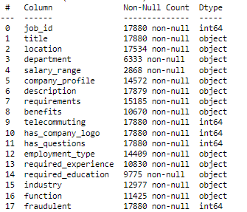
Missing Values and Feature Engineering
Drop salary_range
Extract country and multiple_locations from location
Convert non-categorical text columns into Booleans indicating if a value exists
Bucket industries into top 12 by count and ‘Other’
Drop job_id
One Hot encode all categorical text features

Slide 15
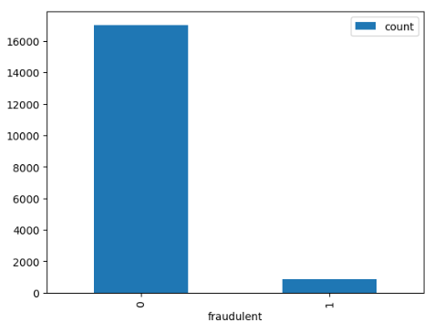
Exploratory Analysis
Imbalanced Data
Fraudulent jobs – 4.8%

Slide 16
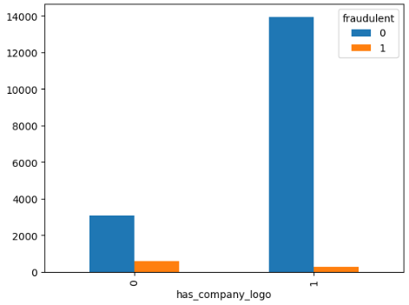
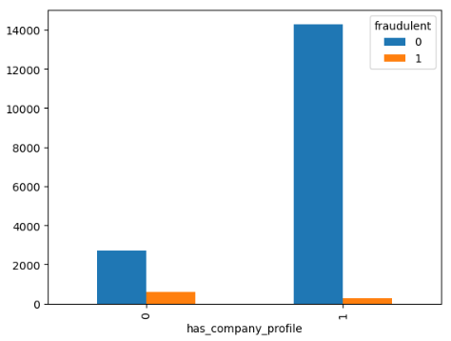
Exploratory Analysis
Greater proportion of fraudulent jobs missing company logo or company profile

Slide 17
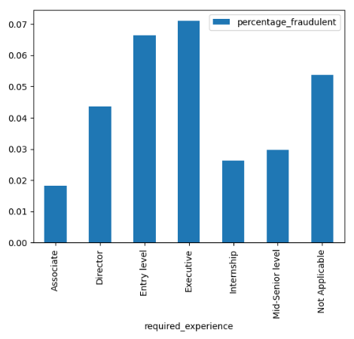
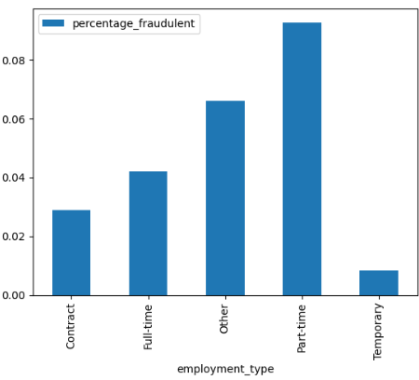
Exploratory Analysis
The most targeted experience levels are Executive and Entry Level
Part Time job listings see the highest rate of fraudulent jobs

Slide 18
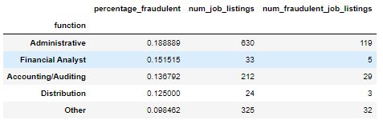
Exploratory Analysis
Administrative and Accounting/Auditing job functions are the ones most frequently targeted by scammers

Slide 19


05
Model Development

Slide 20
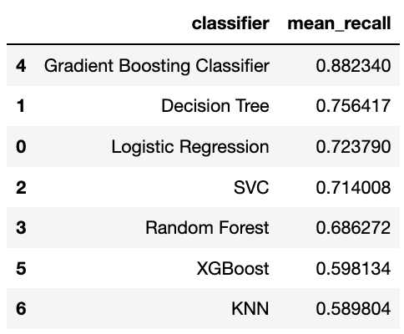
Model Development
We decided to use the following classification models:
Logistic Regression
Decision Tree
LinearSVC
K-Nearest Neighbours
Random Forest
Gradient Boosting Classifier
XGBoost
And compared their performance based on average Recall

Slide 21
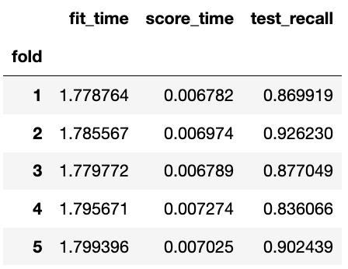
Model Development
Gradient Boosting Classifier has the highest average Recall and has a low fluctuation between Recall across each fold

Slide 22
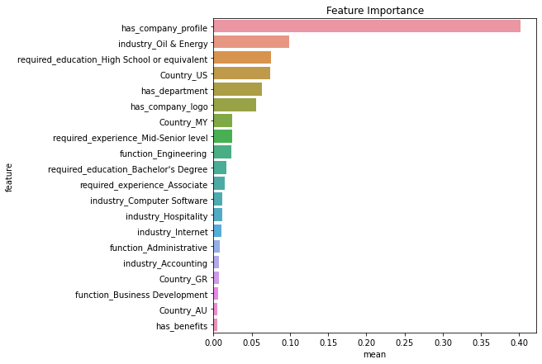
Model Development
Top 20 important features

Slide 23
06
Model Evaluation

Slide 24
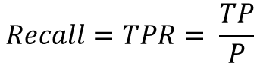
Evaluation using Recall
Recall is chosen because it is preferred to increase the number of True Positives, at the cost of increasing number of False Positives
Additional verification may be requested for any flagged job listing
A minuscule additional cost for a legitimate job posting, but very hard to provide if the job is fake
$$Recall=TPR= \frac{TP}{P}$$

Slide 25
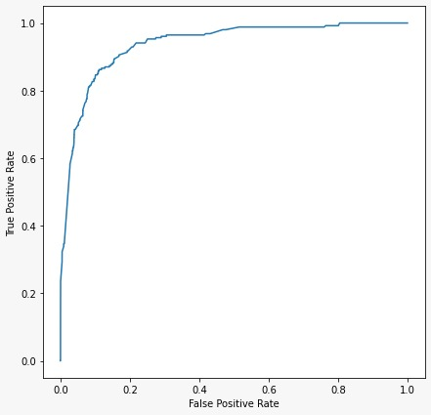
ROC Curve
Our model seems to be performing much better as compared to the “no skill” classifier
However, it was mentioned that ROC is not recommended for highly imbalanced data.
We will explore our models through Confusion Matrix + Cost-Benefit Matrix

Slide 26
Confusion Matrix
 | Predicted Real | Predicted Fake
Actual Real | 4511 | 599
Actual Fake | 35 | 219
 | Predicted Real | Predicted Fake
Actual Real | 0.84 | 0.11
Actual Fake | 0.01 | 0.04
Confusion Matrix is generated based on selected model

Slide 27
Business Assumptions
Revenue gained
Recruitment Services
Advertisement
Premium Subscriptions
$2
Cost of maintaining website per user, there is no other cost involved
$2
Processing cost for additional verification when real job is listed as fake
$5
Penalty cost when fake job is listed as real
$5
Earning generated per actual real click through recruitment services
Will not subscribe to premium subscription | Clicked on the actual fake + did not click on predicted fake (but actual real)
Will subscribe to premium subscription (probability = 0.8) | Clicked on actual real and successfully identified actual fake
$2
Earning generated per predicted real click through advertisement
$5
Earning generated through premium subscription
*Job seekers will follow predicted results (i.e., click in when it’s predicted as real and does not click when it’s predicted as fake)

Slide 28
Cost-Benefit Matrix
 | Predicted Real | Predicted Fake
Actual Real | Recruitment service earning + Advertisement earning + Premium Subscription – Maintenance cost | – Maintenance cost – Processing cost
Actual Fake | Advertisement Earning – Maintenance cost – penalty cost | Premium subscription – Maintenance cost
 | Predicted Real | Predicted Fake
Actual Real | $5 + $2 + $5*0.8 – $2 = $9 | -$2 - $2 = -$4
Actual Fake | $2 – $2 - $5 = -$5 | $5*0.8 - $2 = $2

Slide 29
Expected Value Framework
 | Predicted Real | Predicted Fake
Actual Real | 0.84*$9 = 7.56 | 0.11*(-$4) = -0.44
Actual Fake | 0.01*(-$5) = -0.05 | 0.04*($2) = 0.08
Expected Value = 7.56 + (-0.05) + (-0.44) + 0.08 = $7.15

Slide 30
07
Recommendation

Slide 31
Recommended Use
Website
Expected Value
Verification
Model can be utilized by job posting websites such as Indeed and JobStreet
Confusion Matrix is constructed and Cost-Benefit Analysis is implemented based on specific needs
Emails are sent to companies with job listings determined to be fake for additional verification

Slide 32
08
Conclusion

Slide 33
Conclusion
Data Preparation & EDA
Gradient Boosting Classifier
Recall
Data Understanding
Highest Recall score
True Positive results
Confusion Matrix
Cost-Benefit Matrix
Suggestion
True Positive Rate
Business Assumptions
Job board websites

Slide 34

THANK YOU

